Slide 1
Digital Agriculture Recommender System (DARS)
SRS + SDS Presentation
Prepared By: Anas, Talha, Mustafa

Slide 2
Introduction & Project Overview
Purpose of DARS
Problem Statement
To provide data-driven recommendations, aiding farmers in making informed decisions for optimal agricultural practices.
Farmers often rely on intuition or outdated methods, leading to inefficiencies, crop losses, and reduced profitability.
Proposed Solution
Intended Audience
A web-based rule-based system for crop prediction, soil suitability, disease diagnosis, and market insights.
Farmers, agronomists, project stakeholders, and technical reviewers involved in agricultural technology.

Slide 3

Addressing Core Agricultural Challenges
The Problem Statement
Inaccurate Crop Decisions: Farmers often lack precise data for optimal crop selection and management.
Lack of Scientific Recommendations: Over-reliance on traditional methods without scientific backing.
Scattered Datasets: Critical agricultural data is fragmented and not easily accessible for analysis.
Disease Misdiagnosis: Difficulty in accurately identifying and treating crop diseases, leading to significant losses.

Slide 4





Our Digital Solution: DARS
Web-Based System
Crop Prediction
Soil Suitability
Accessible platform for comprehensive agricultural recommendations.
Accurate suggestions for suitable crops based on various parameters.
Matching crops to specific soil conditions for maximized yield.
Disease Diagnosis
Market Demand Insight
Identifying crop diseases and recommending effective treatments.
Forecasting market trends to optimize planting and sales strategies.

Slide 5
Functional Requirements: Core Operations
The essential tasks and processes DARS must perform.
01
02
Crop Recommendation
Soil Suitability:
Get crop suggestions based on soil, season, and demand.
Rule-based engine analyzes data against knowledge base for matches and inferences.
03
04
Disease Treatment:
Recommendation:
Input disease symptoms and get treatment recommendations.
Generate rule-based suggestions.

Slide 6
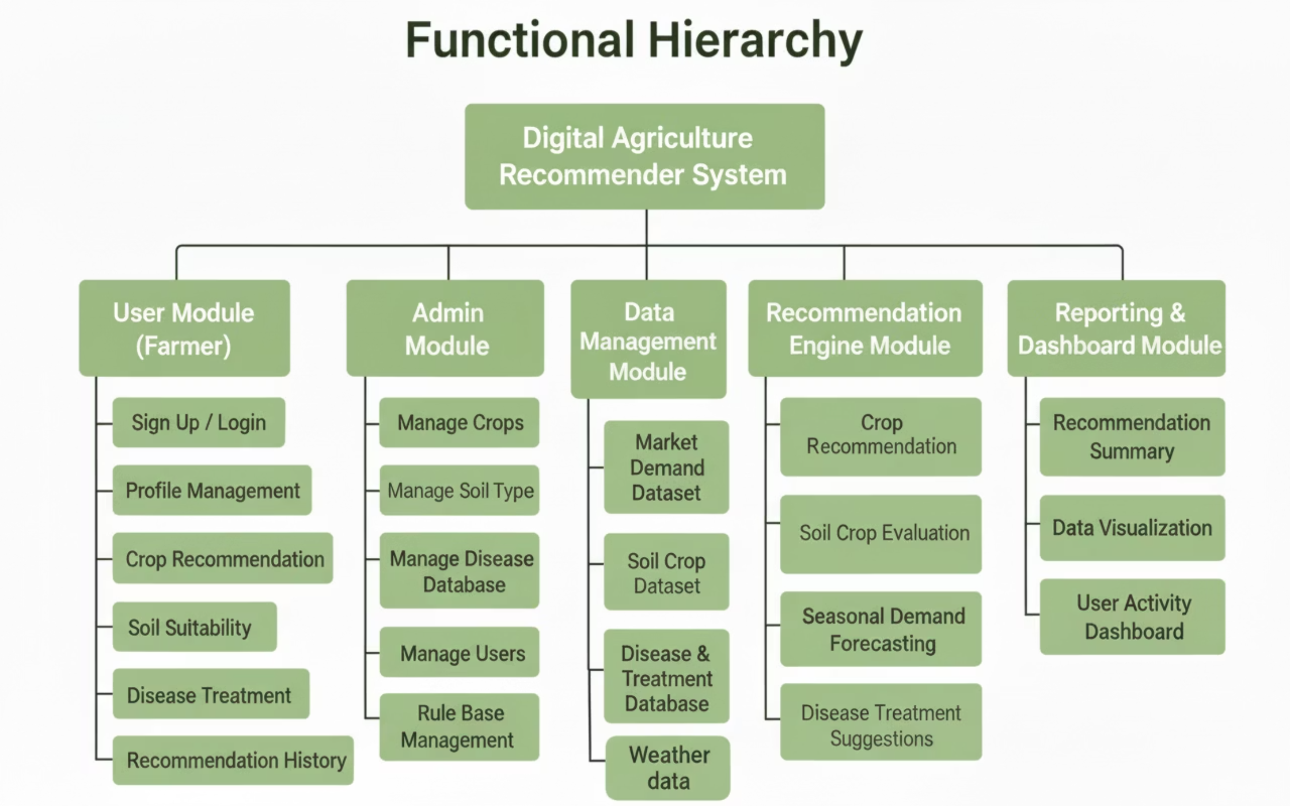

Slide 7
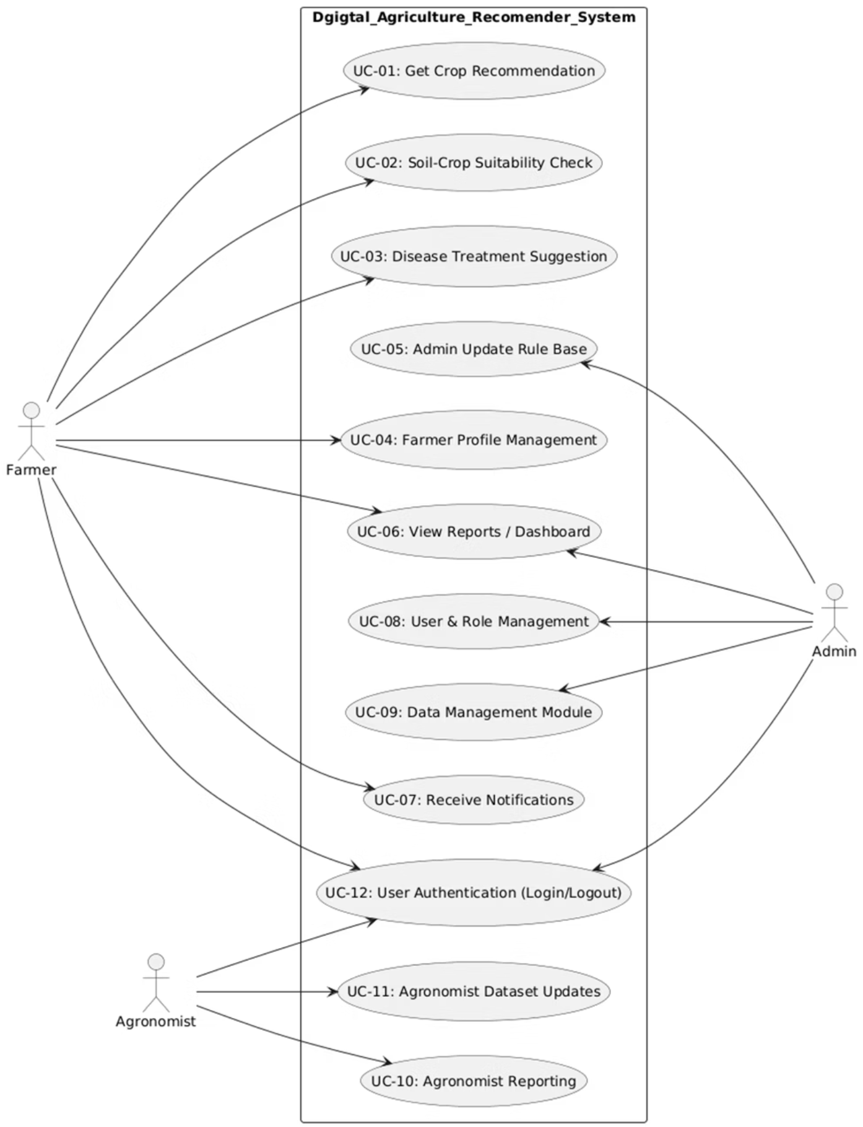
Use Case Diagram

Slide 8
Non - Functional Requirements
1
2
Performance Requirements
Safety Requirements
System responds within 2–3 seconds for all recommendations.
Prevents unsafe/banned chemical suggestions & validates user inputs.
Supports 500+ concurrent users with 99% uptime.
Daily secure backups and audit logs for rule/dataset changes.
3
4
Security Requirements
User Documentation
Password and encrypted data storage.
Simple Farmer Guide, Admin Manual, and Quick Start Guide provided.
Admin/agronomist access.
Training materials (slides & videos) available for users.

Slide 9



System Architecture
Presentation Layer (Frontend)
Handles user interaction, collects inputs, and displays recommendations.
Application / Business Logic Layer (Backend)
Processes rules, executes recommendation logic, and manages system workflows.
Data Layer (Database)
Stores users, crops, soils, diseases, rules, and retrieves data for processing.

Slide 10
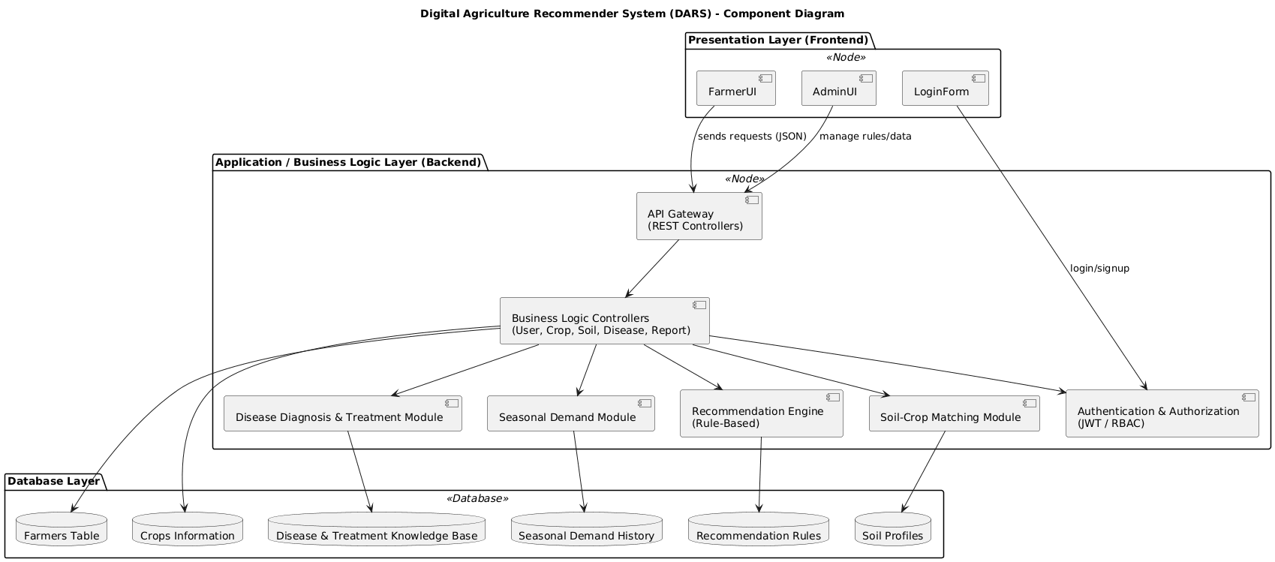

Slide 11
Domain Model
These are the main conceptual objects of DARS and how they relate.
Farmer
Soil
Crop
Primary user requesting recommendations
Stores soil type, pH, fertility
Contains crop attributes (season, requirements)
Used for soil–crop matching
Provides soil data & symptoms
Used in recommendation generation
Disease
Treatment
Recommendation
Stores disease names & symptoms
Provides chemical/organic treatment options
Final advice (crop, soil, disease, demand)
Linked to crops for diagnosis
Attached to diseases
Generated by rule engine
Admin
Rule Set
Demand Trend
Manages datasets & rules
IF–THEN logic for recommendations
Stores seasonal/historical demand
Ensures system accuracy
Updated by admin/agronomist
Supports demand forecasting

Slide 12
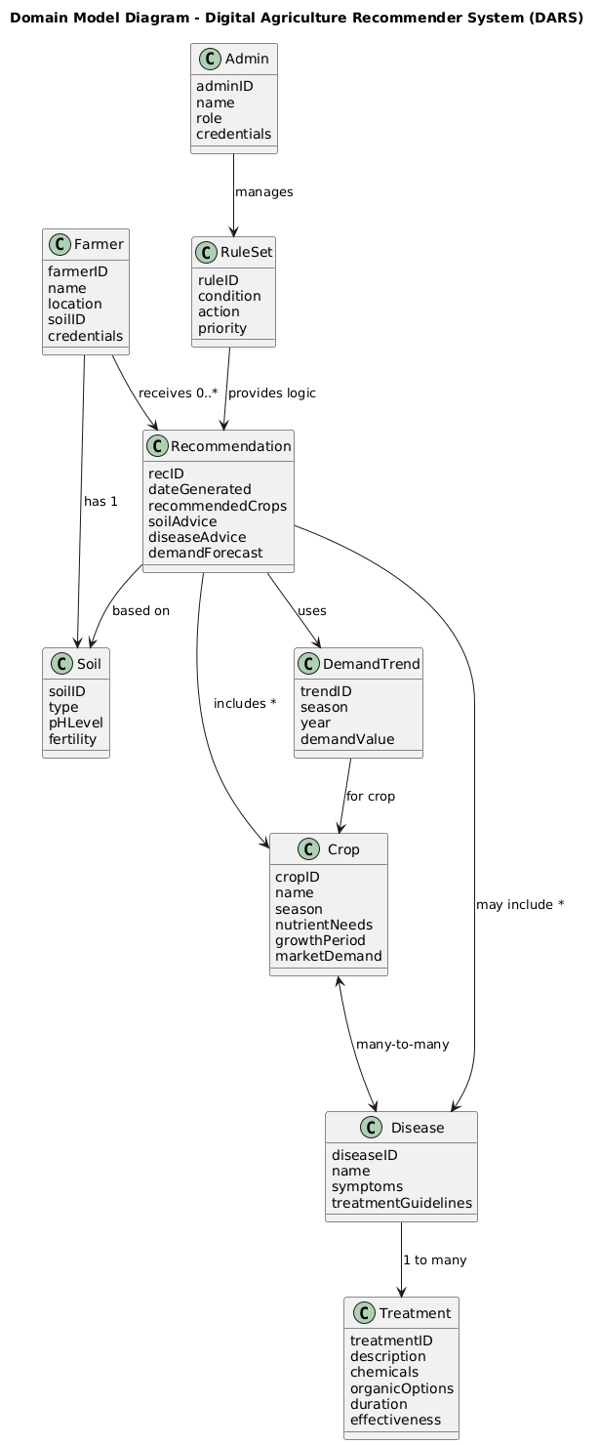

Slide 13
Class Diagram
User (Abstract Class)
Farmer (inherits User)
Admin (inherits User)
Base class for all system users; handles authentication and profiles.
Requests recommendations and views results/history.
Manages users, rules, and all system datasets.
Agronomist (inherits User)
Crop
Soil
Validates recommendations and updates domain knowledge.
Stores crop data (season, nutrient needs, demand, suitability).
Stores soil properties for suitability and improvement analysis.
Disease
Treatment
Demand Trend
Represents crop diseases and symptom-based identification.
Treatment options linked to diseases; includes chemical/organic solutions.
Historical/seasonal crop demand data for forecasting.
Rule
Recommendation Engine
Recommendation
Defines IF–THEN logic used by the recommendation engine.
Processes rules and generates all system recommendations.
Final output combining crop, soil, disease, and demand insights.

Slide 14
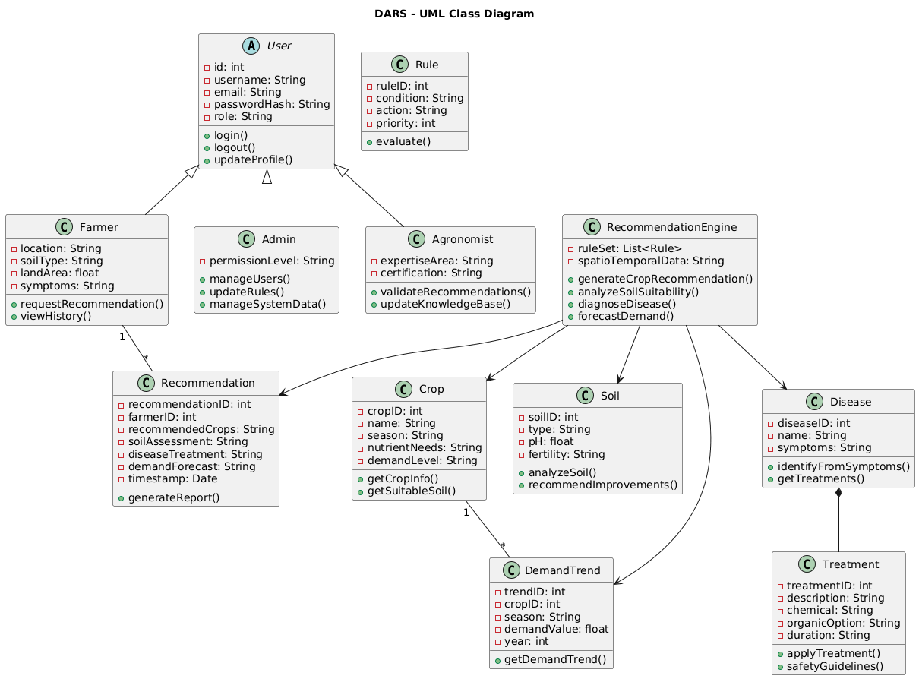

Slide 15
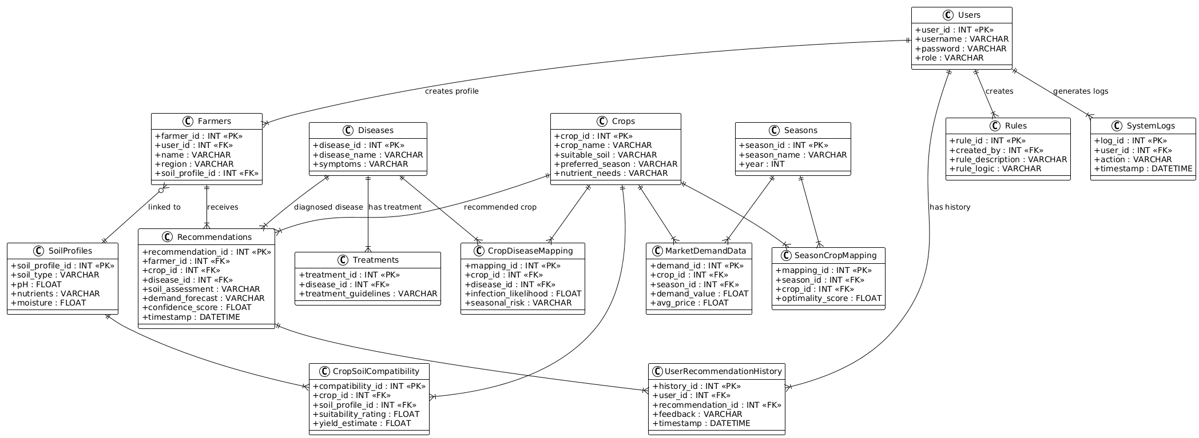
Database Diagram

Slide 16
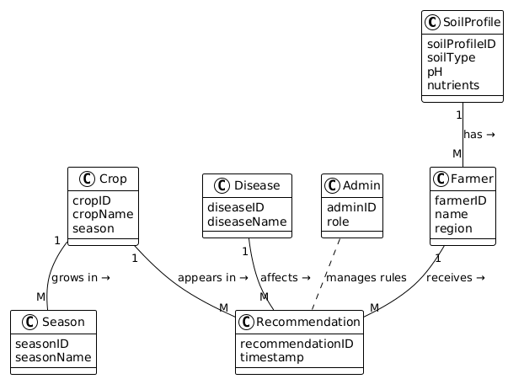
Entity Relationship Diagram

Slide 17
Sequence Diagram
Key Participants
Farmer (UI)
Authentication Service
API Gateway / Controller
Recommendation Engine
Database
Main Process/Flow
Farmer submits recommendation request via UI.
Auth Service validates session token.
UI sends request to API Gateway with soil, region, season & symptoms.
API validates token again for security.
API retrieves soil profile, crop data, and demand trends from DB.
API sends full request to Recommendation Engine.
Recommendation Engine fetches rules, diseases, treatments from DB.
Engine applies rule-based logic → generates recommendation.
Engine stores the recommendation into the DB.
API returns the final recommendation to the Farmer UI.

Slide 18
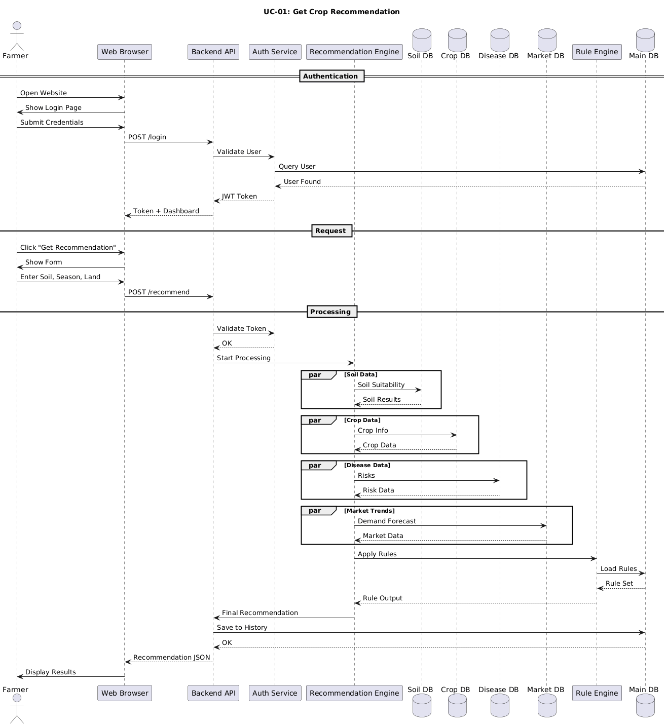
Use Case 01:

Slide 19
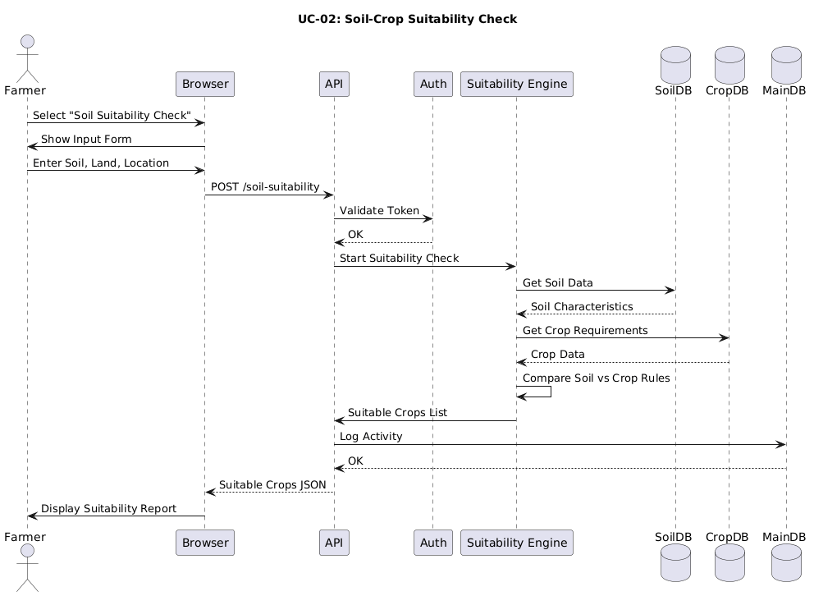
Use Case 02:

Slide 20
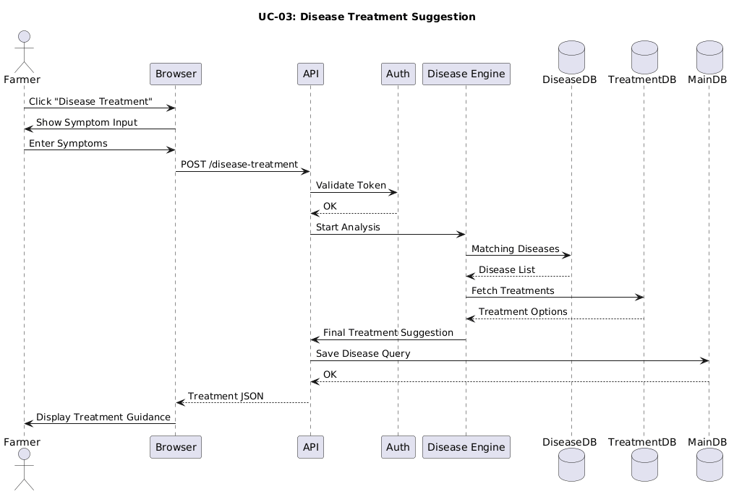
Use Case 03:

Slide 21
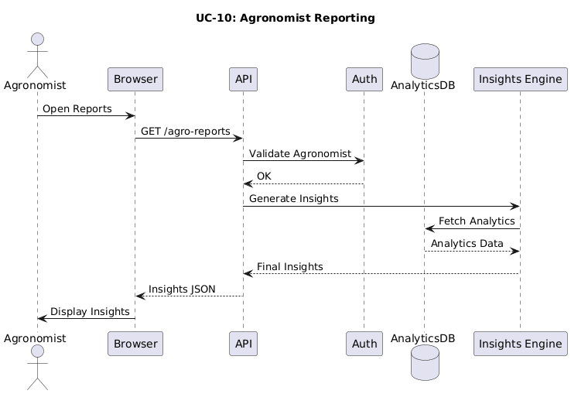
Use Case 04:

Slide 22
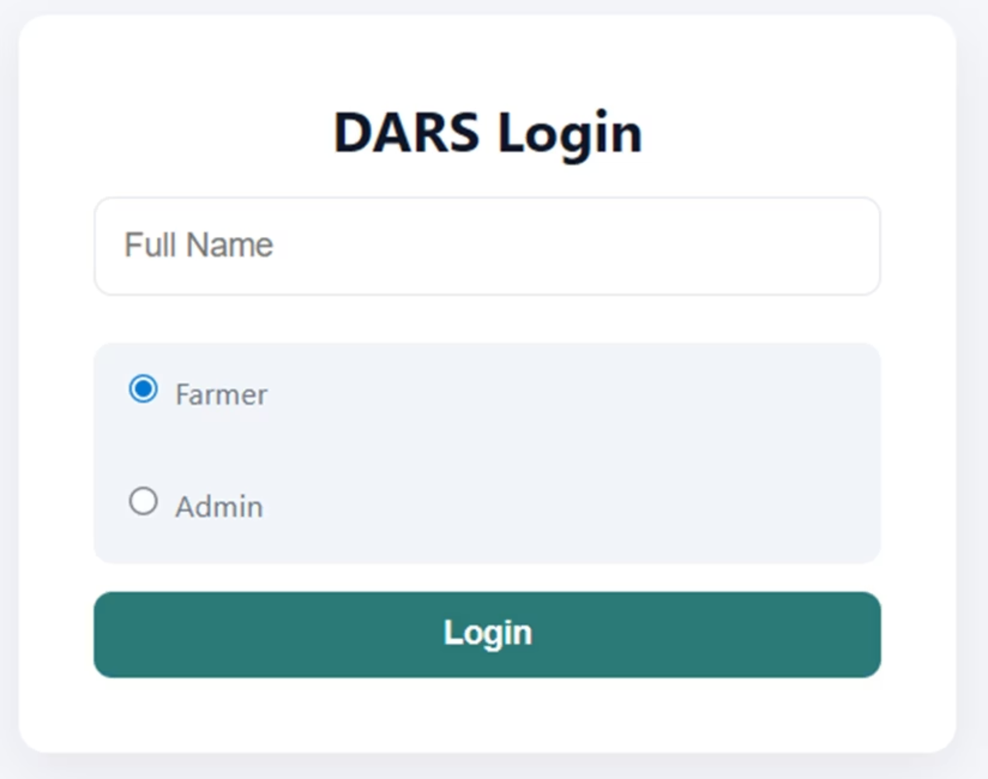
System Interface Design
Login Screen (Farmer / Admin)

Slide 23
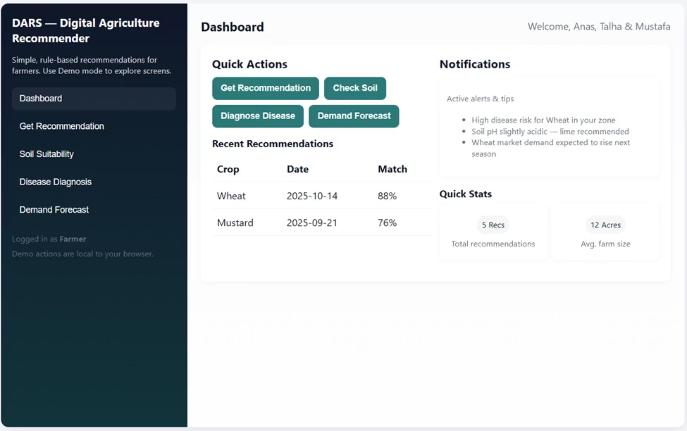
Farmer Dashboard

Slide 24
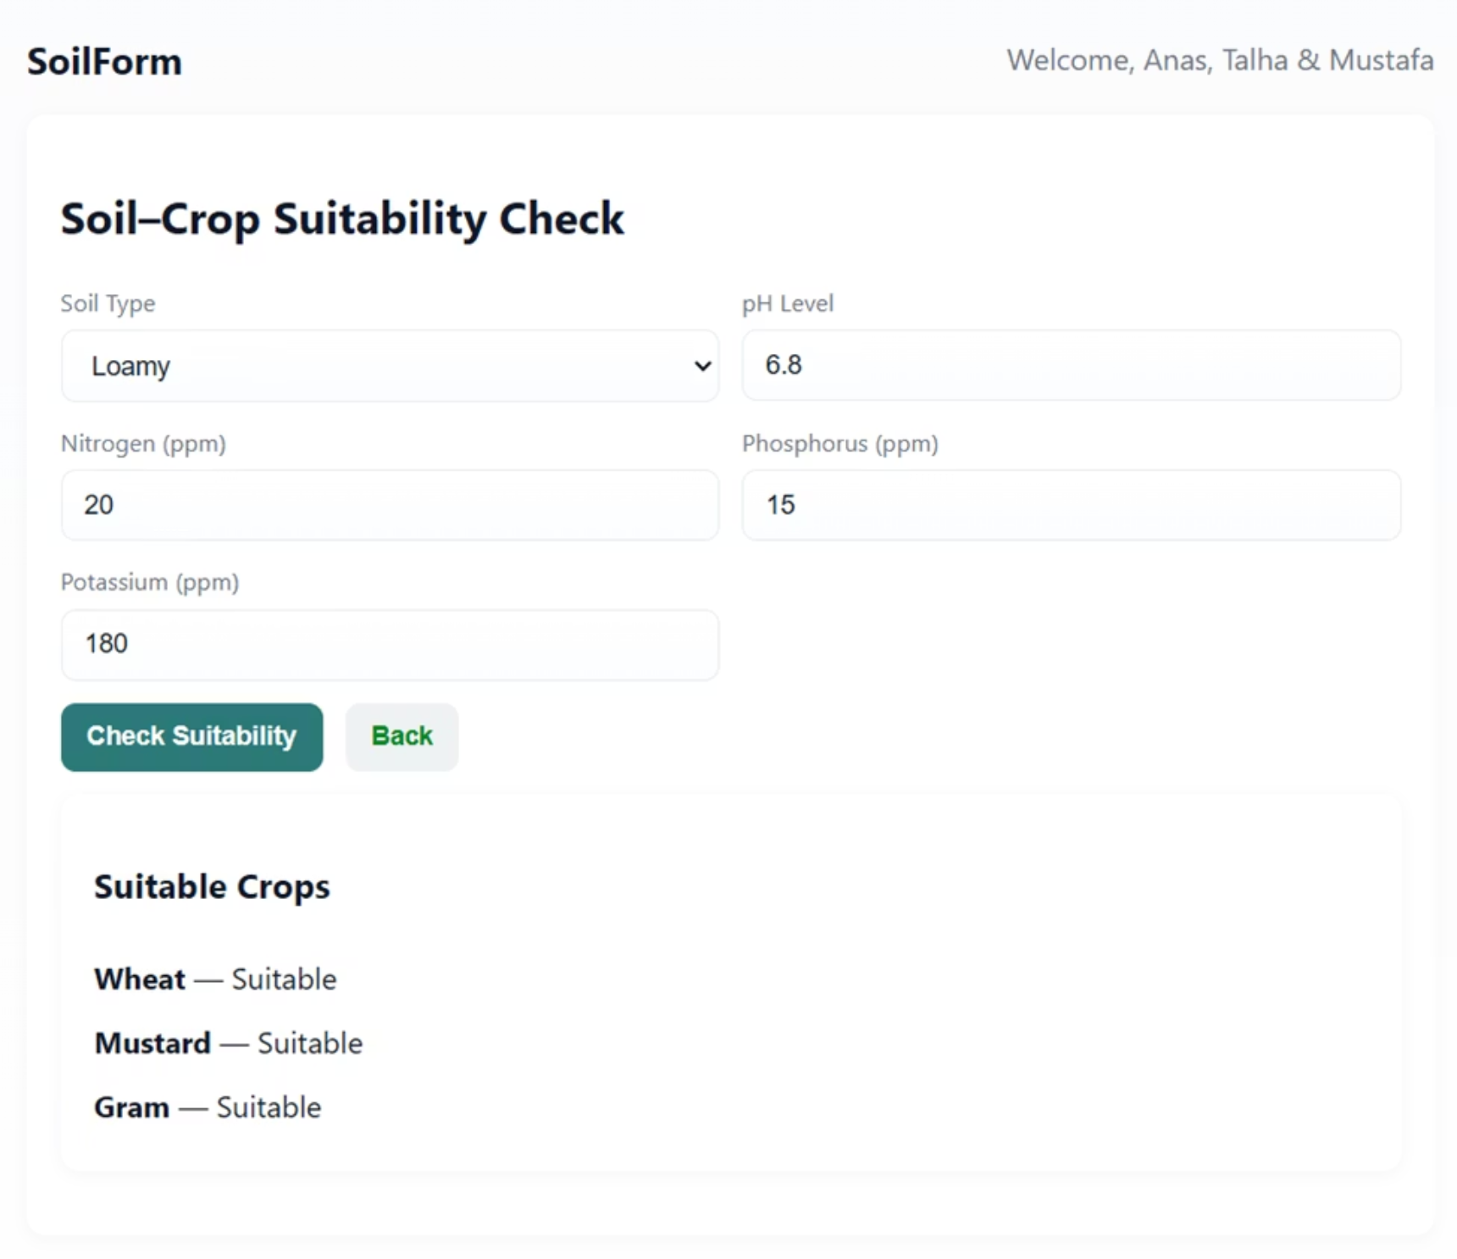
Soil Input Form

Slide 25
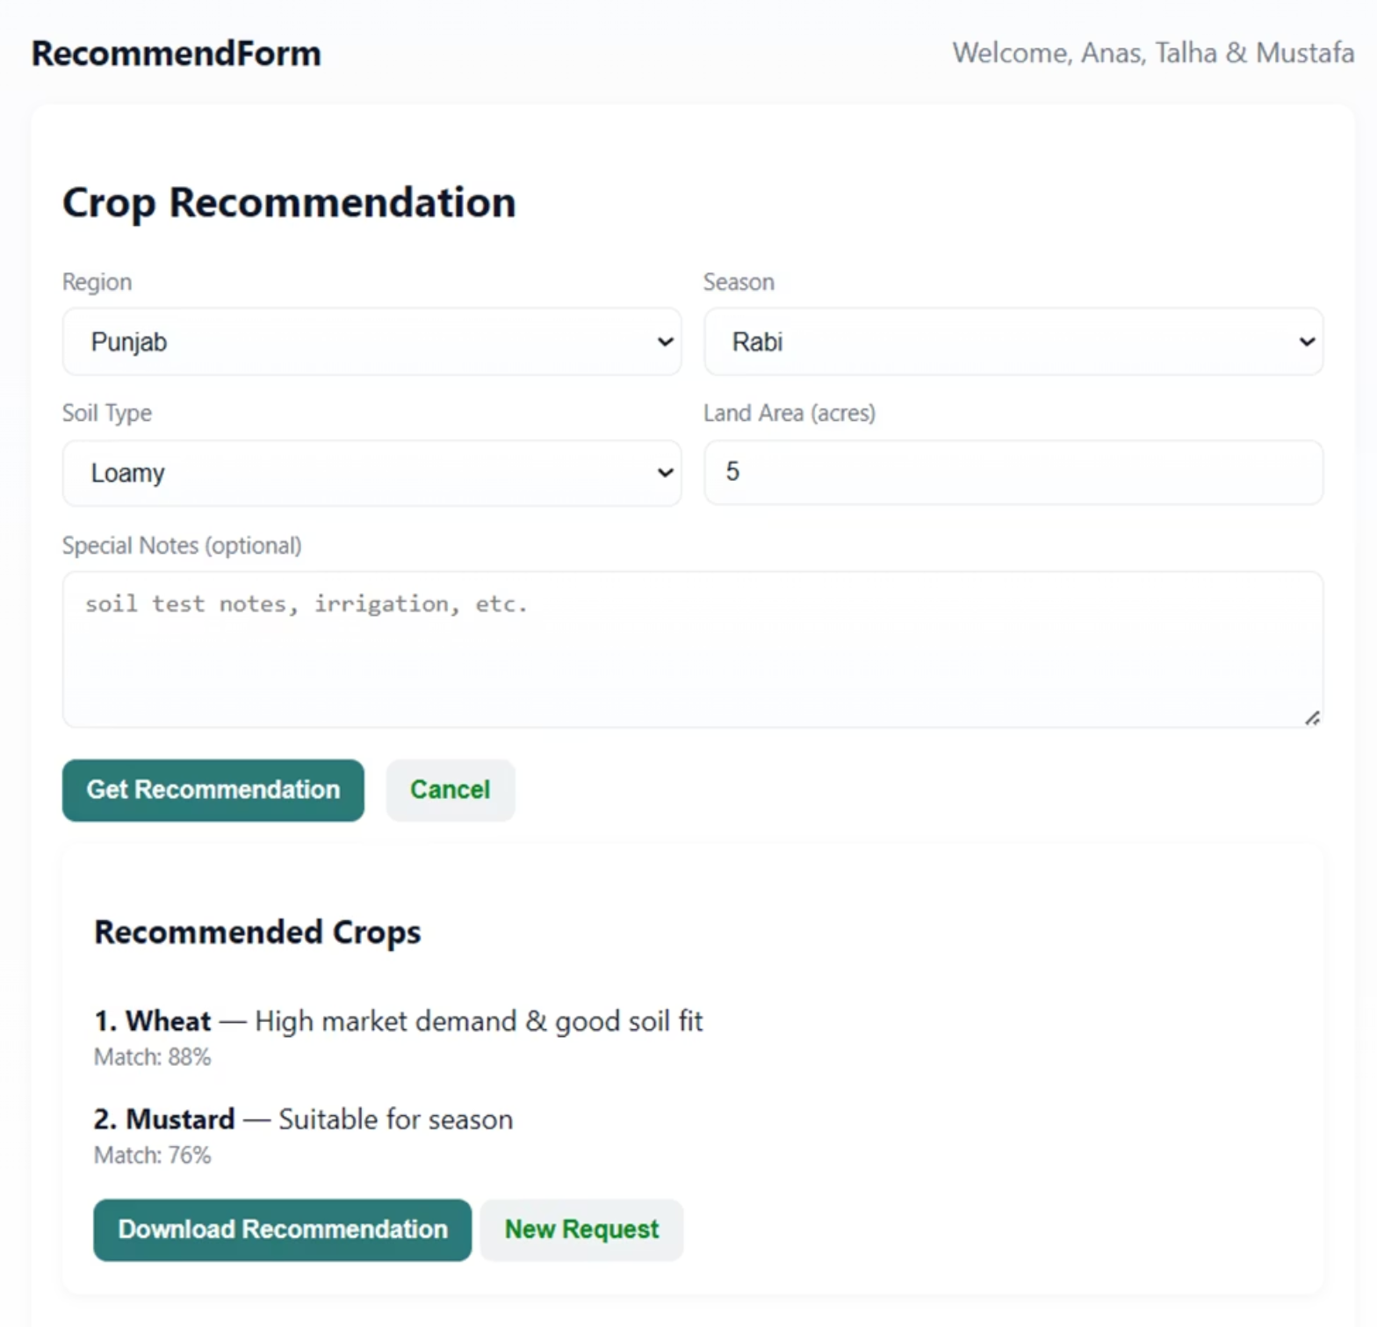
Crop Recommendation Screen

Slide 26
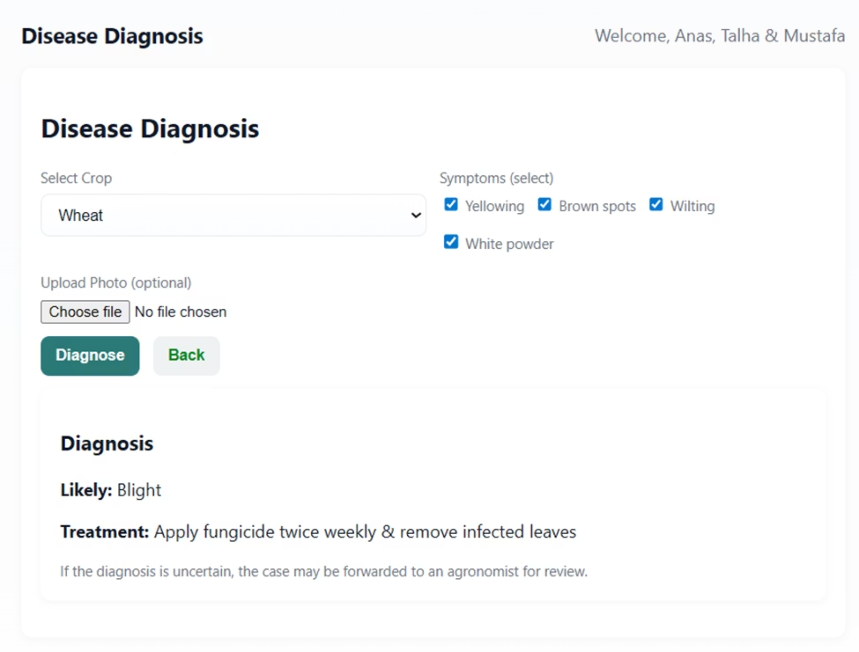
Disease Diagnosis Interface

Slide 27
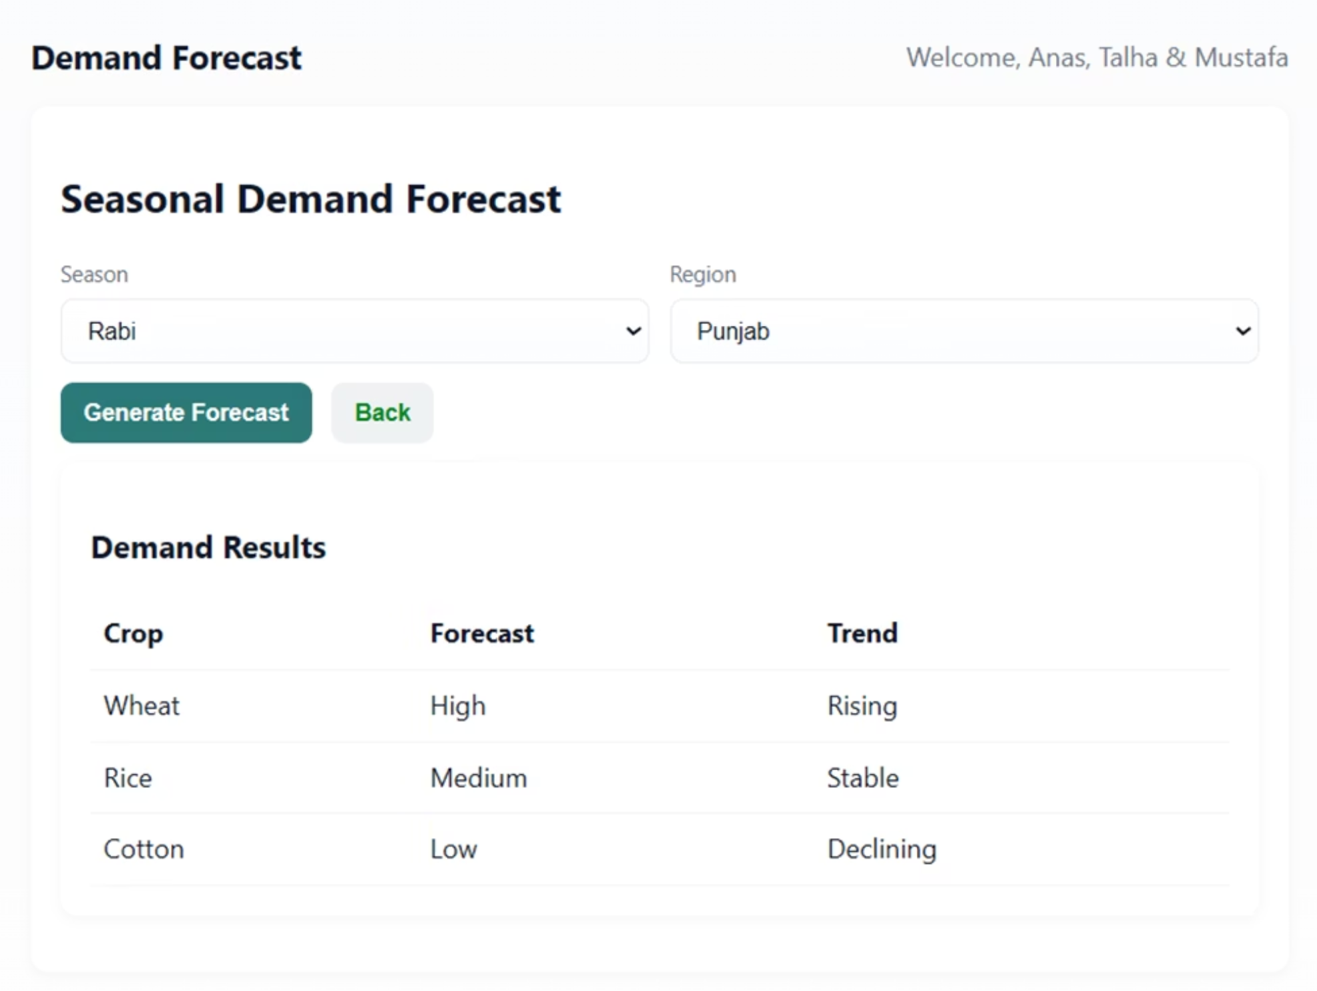
Seasonal Demand Forecast Screen

Slide 28
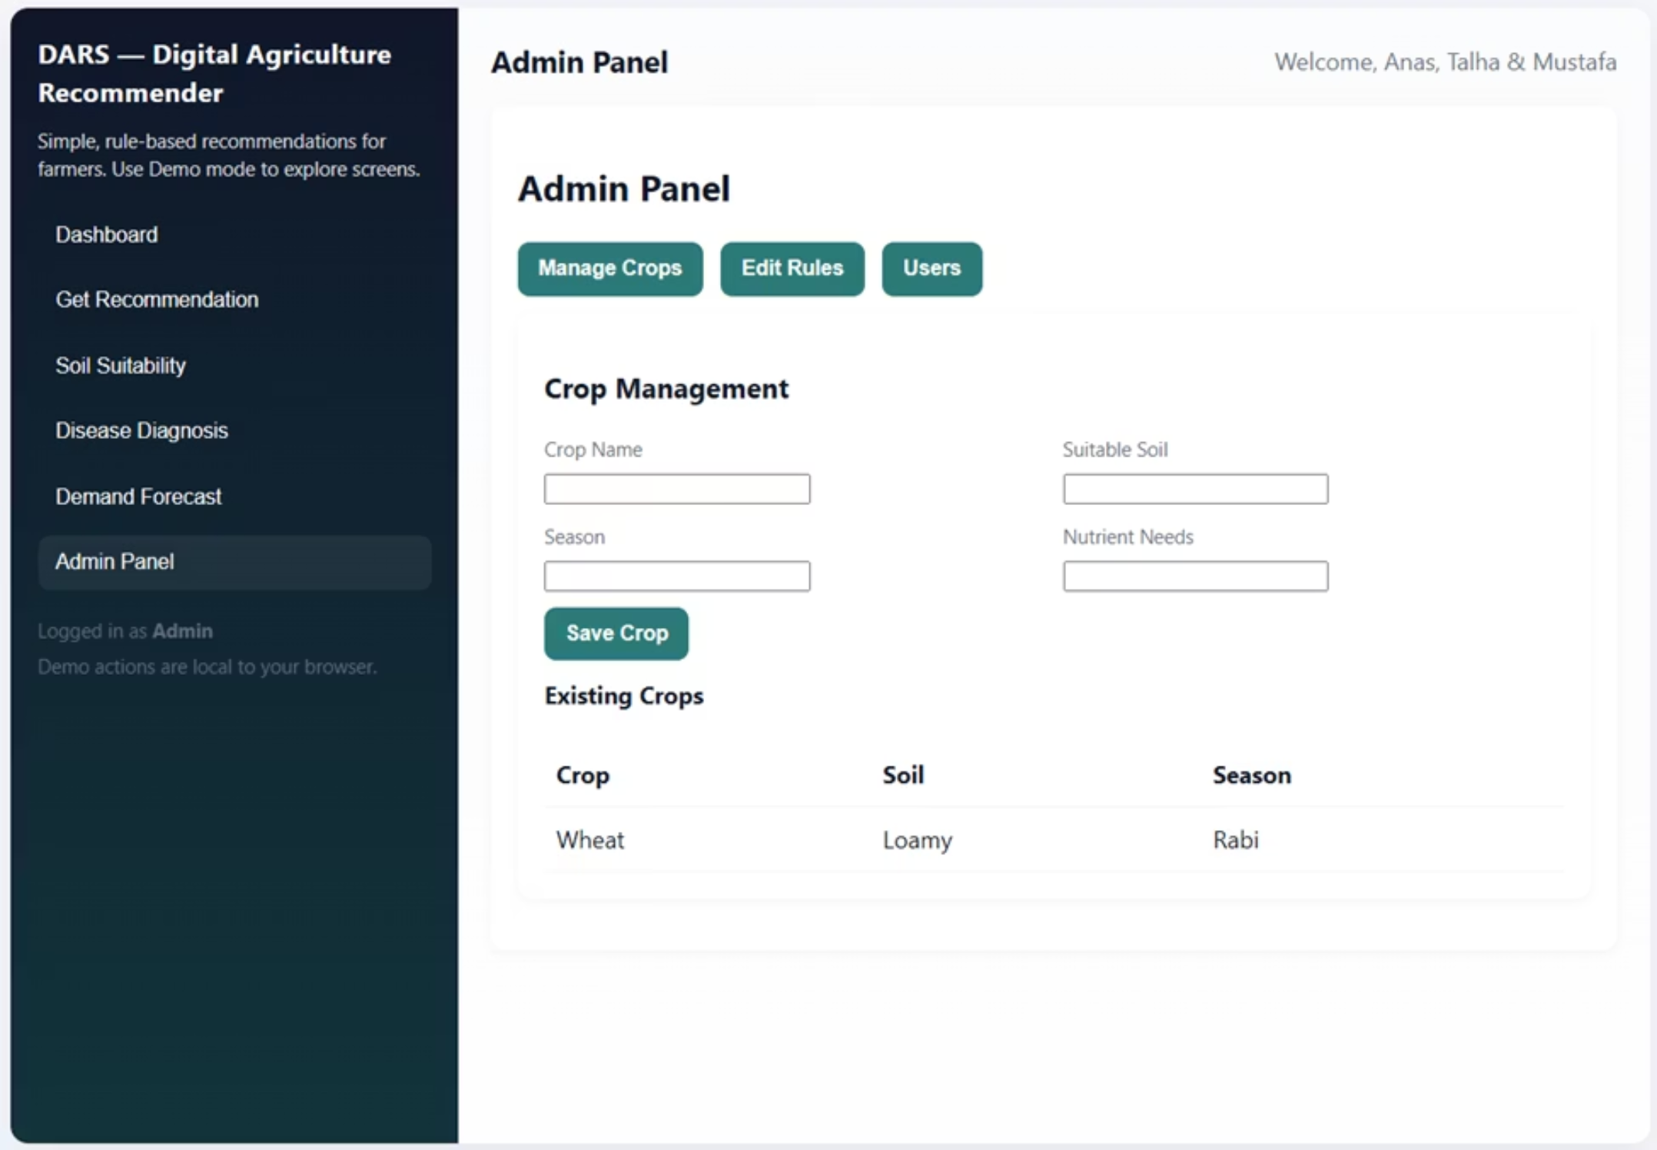
Admin Panel Dashboard

Slide 29
Test Cases
TC-AUTH-02: Invalid User Login
TC-FARM-01: Crop Recommendation Request
TC-FARM-02: Soil Suitability Check
Inputs: wrong username & password
Inputs: Loamy soil, Rabi season, Punjab, 5 acres
Inputs: Sandy soil
Expected Output: “Invalid credentials”, no redirection
Expected Output: Suitable crops + compatibility rating (<2s)
Expected Output: 2–3 crop suggestions, confidence %, soil & disease notes, <3s response
TC-FARM-03: Disease Diagnosis
TC-REC-01: Rule Logic Validation
TC-INT-01: End-to-End Flow
Inputs: Wheat + symptoms (yellow leaves, brown spots)
Inputs: Loamy soil + Rabi
Steps: Register → Login → Update soil → Get recommendation → Disease diagnosis → Logout
Expected Output: Wheat recommended with high confidence
Expected Output: Disease match + treatment + prevention
Expected Output: Full workflow succeeds

Slide 30
fin.

